Slide 1
路由器

Slide 2
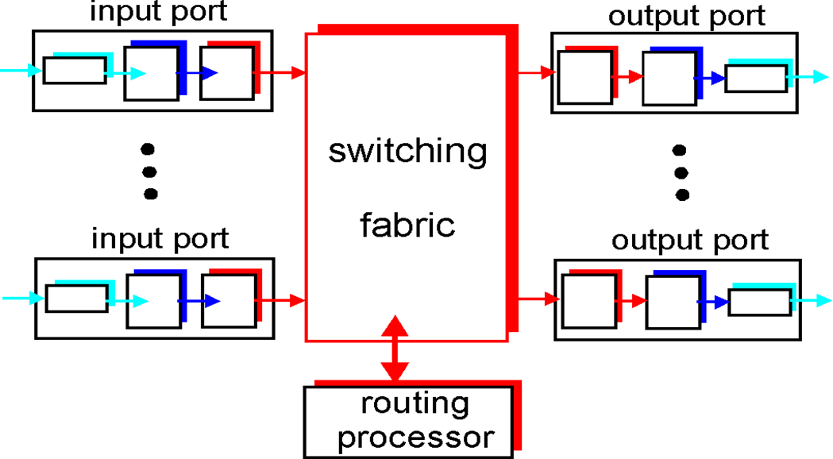
Router Architecture Overview
Two key router functions:
run routing algorithms/protocol (RIP, OSPF, BGP)
forwarding datagrams from incoming to outgoing link

Slide 3
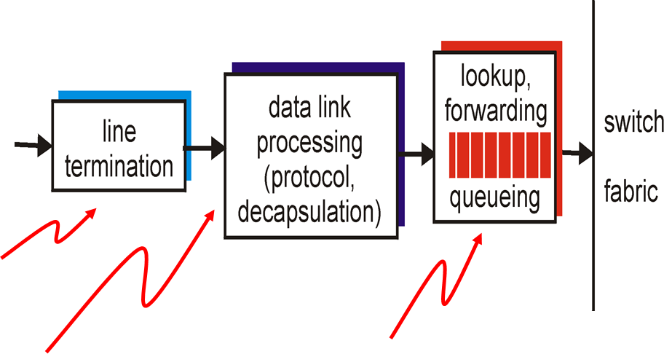
Input Port Functions
Physical layer:
bit-level reception
Decentralized switching:
given datagram dest., lookup output port using forwarding table in input port memory
goal: complete input port processing at ‘line speed’
queuing: if datagrams arrive faster than forwarding rate into switch fabric
Data link layer:
e.g., Ethernet
see chapter 5

Slide 4
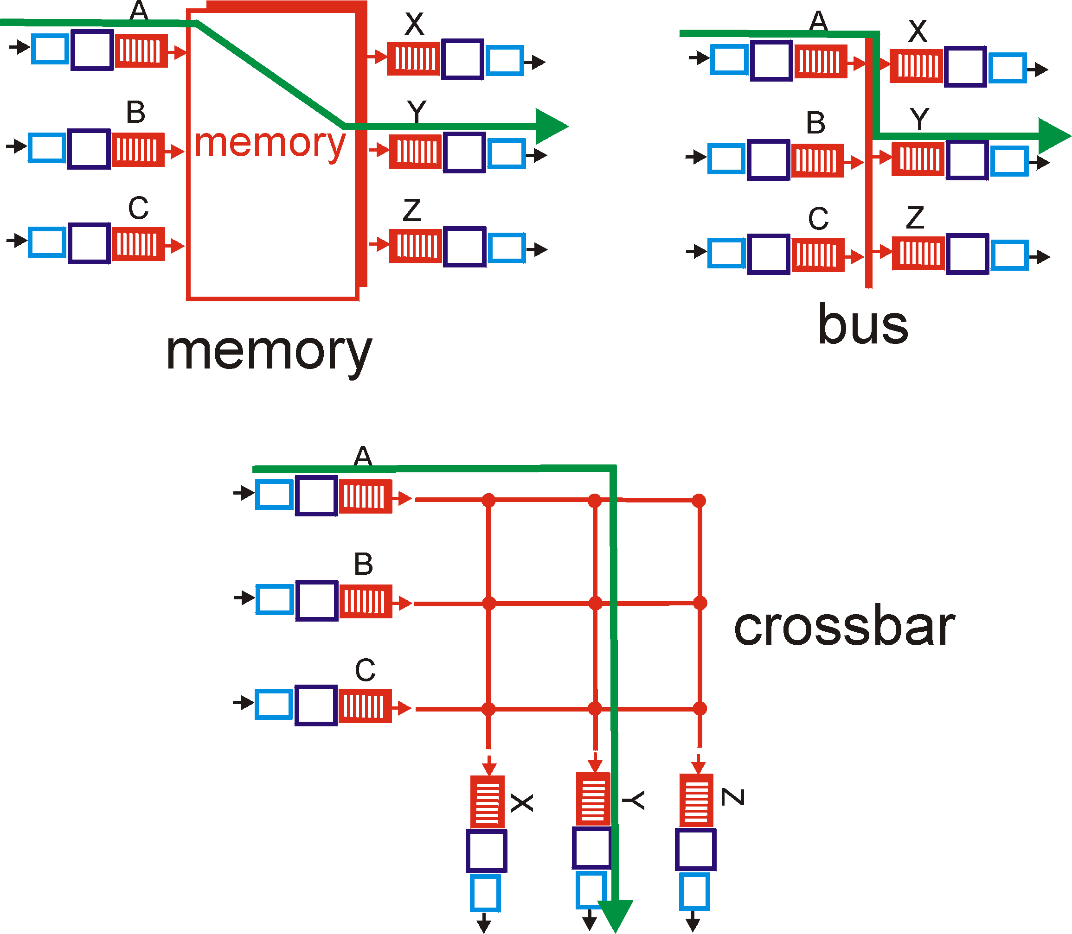
Three types of switching fabrics

Slide 5
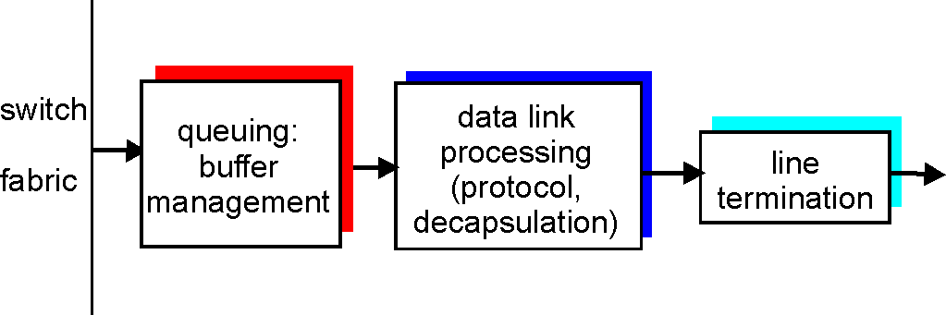
Output Ports
Buffering required when datagrams arrive from fabric faster than the transmission rate
Scheduling discipline chooses among queued datagrams for transmission

Slide 6
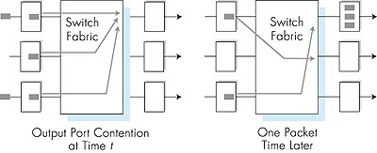
Output port queueing
buffering when arrival rate via switch exceeds output line speed
queueing (delay) and loss due to output port buffer overflow!

Slide 7
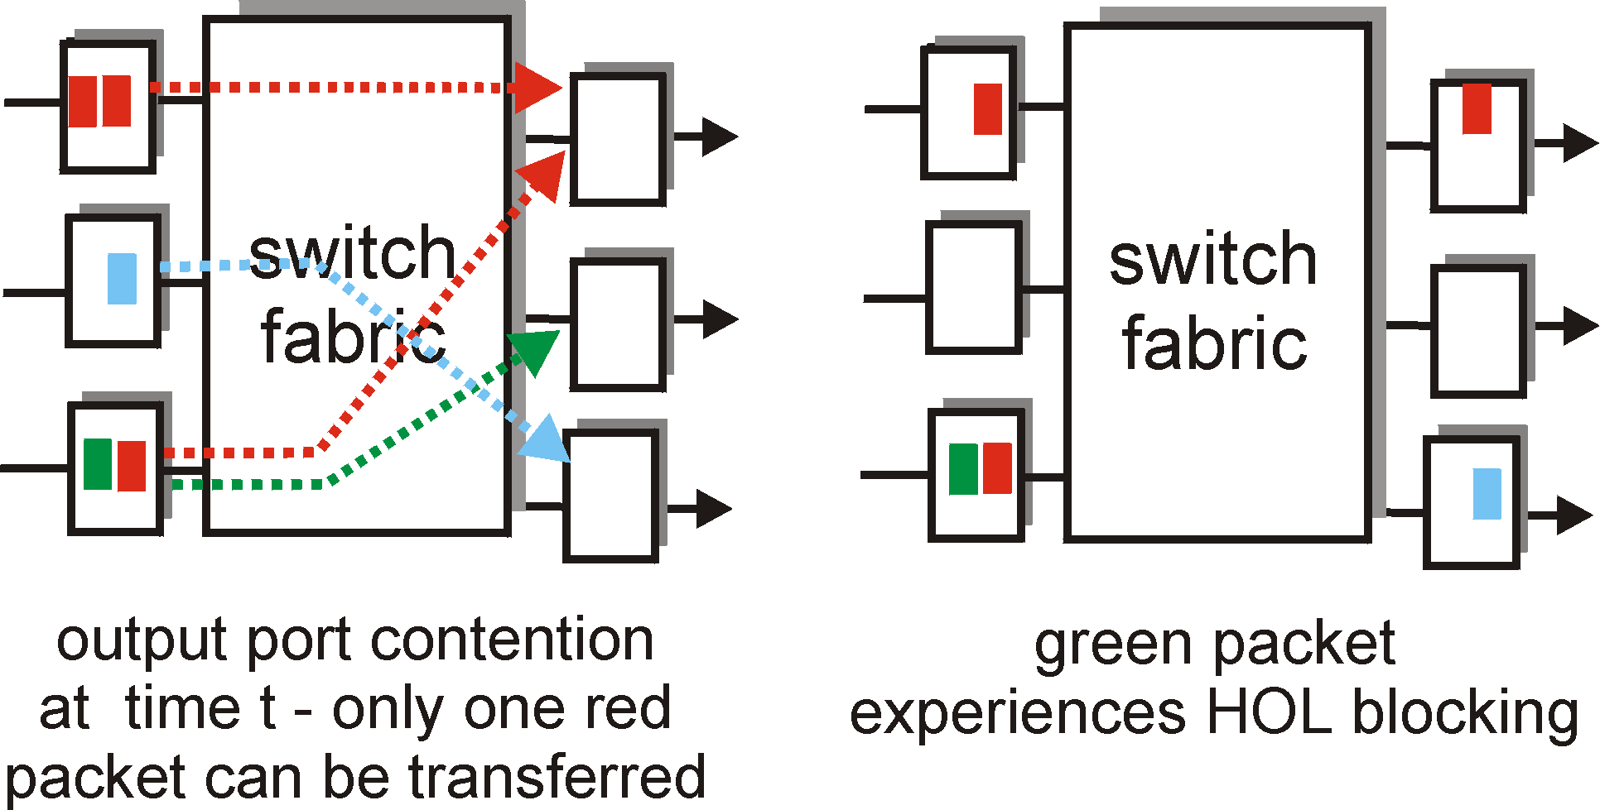
Input Port Queuing
Fabric slower than input ports combined -> queueing may occur at input queues
Head-of-the-Line (HOL) blocking: queued datagram at front of queue prevents others in queue from moving forward
queueing delay and loss due to input buffer overflow!

Slide 8

Summary
Router structure

